Slide 1
Timeline TakeDown
Maybe record the game in the background and voice over it

Slide 2
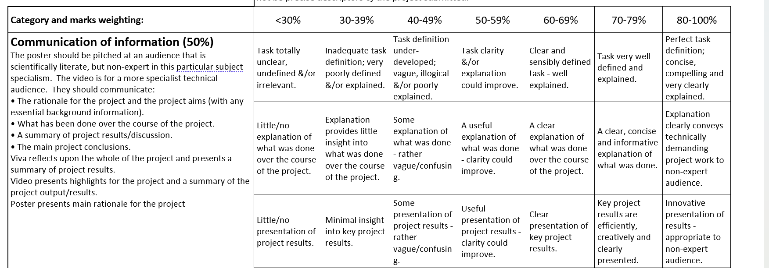

Slide 3
1. The background to your project. Explain to the viewer the context so they understand what you were aiming to achieve. Consider the following questions to help elaborate the background:
Why were you looking at this?
What were the issues that needed solving with software?
Who will benefit from this system?
2. Show the key features of your system. Show it running. Show off the aspects you are most proud of.
3. Whilst the video must be narrated by yourself, it is not essential for you to appear in the video.

Slide 4
Run thro
Game can be downloaded from itch
Launch
Listen to cuscene
Skip to 1-5 pick up part 1-5 end scene (SHOW OFF POWER UPS TOO)
Maybe just film thro the whole game and cut up important pieces

Slide 5
Why I made this

Slide 6
What is unique
Wavemanager system where u can drop and drag
How easy it is now to make new levels

Slide 7
Who will like this
Category of people

